Slide 1

Lecture 1: Learning Systems
CSET 301
Module 1

Slide 2
Topics to be Covered
Designing a learning system
Types of machine learning
Supervised learning
Unsupervised learning
Reinforcement Learning

Slide 3
What is Learning?
3
Herbert Simon: “Learning is any process by which a system improves performance from experience.”
“A computer program is said to learn from experience E with respect to some class of tasks T and performance measure P, if its performance at tasks in T, as measured by P, improves with experience E.”
– Tom Mitchell
Notes:
3

Slide 4

Why do we want Machines to Learn?
There are a multitude of use cases that machine learning can be applied to in order to
cut costs
mitigate risks
improve overall quality of life
recommending products/services
detecting cybersecurity breaches
enabling self-driving cars
With greater access to data and computation power, machine learning is becoming more ubiquitous every day and will soon be integrated into many facets of human life.

Slide 5
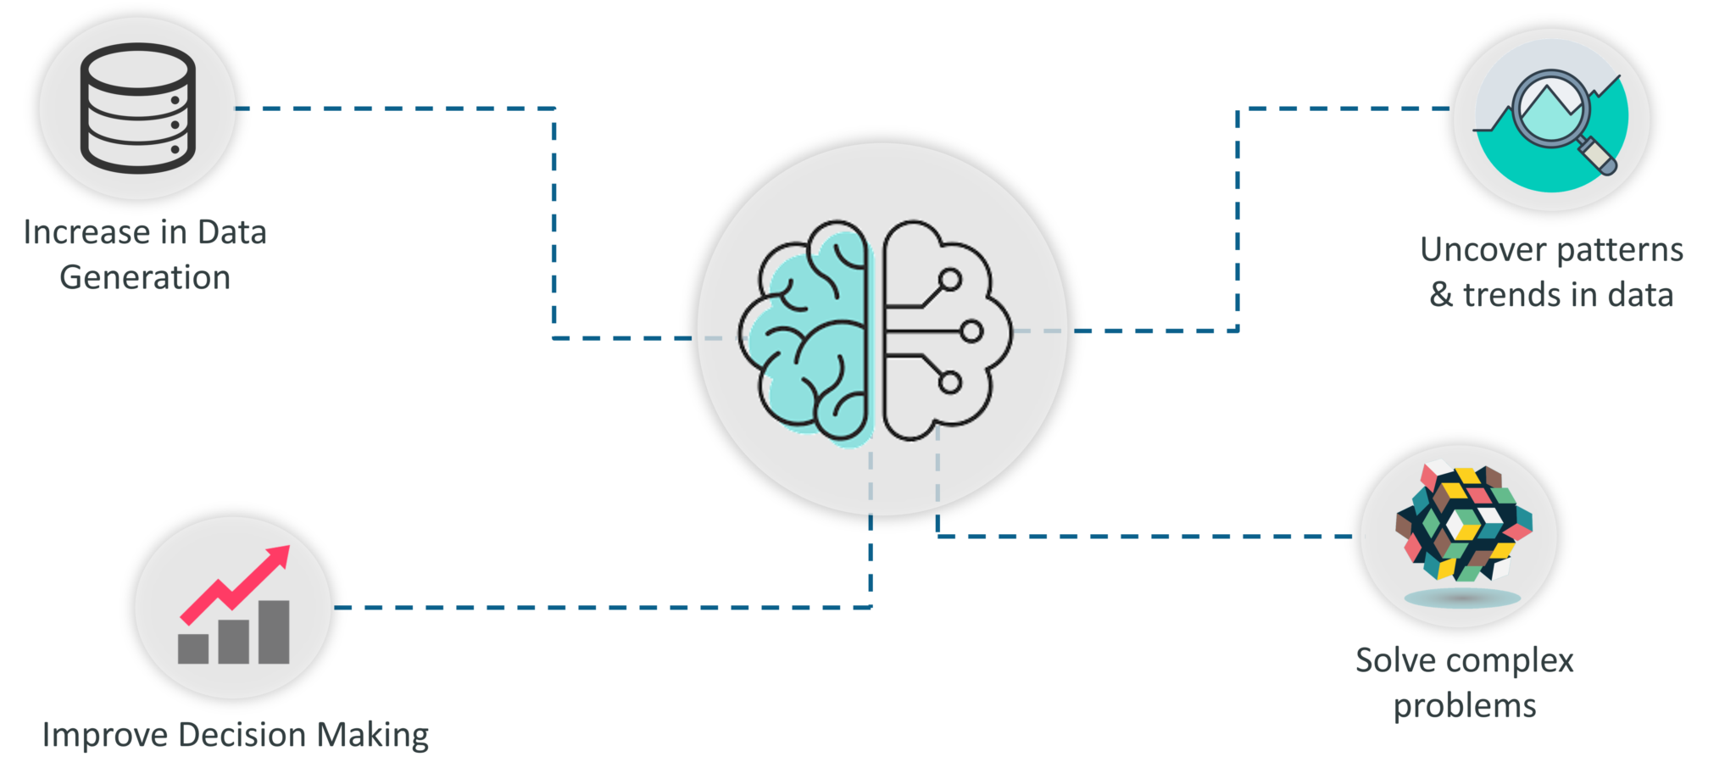

Slide 6
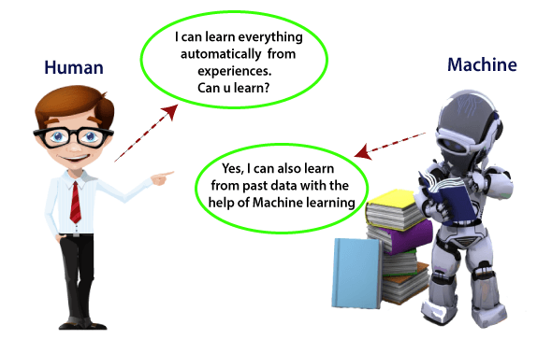
What is Machine Learning??
In the real world, we are surrounded by humans who can learn everything from their experiences with their learning capability, and we have computers or machines which work on our instructions.
But can a machine also learn from experiences or past data like a human does? So here comes the role of Machine Learning.
Machine Learning is a subset of artificial intelligence that is mainly concerned with the development of algorithms which allow a computer to learn from the data and past experiences on their own.

Slide 7
Machine learning and our focus
Like human learning from past experiences.
A computer does not have “experiences”.
A computer system learns from data, which represent some “past experiences” of an application domain.
Our focus: learn a target function that can be used to predict the values of a discrete class attribute, e.g., approve or not-approved, and high-risk or low risk.
The task is commonly called: Supervised learning, classification, or inductive learning.

Slide 8
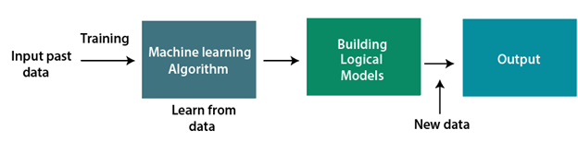
How it Works?

Slide 9
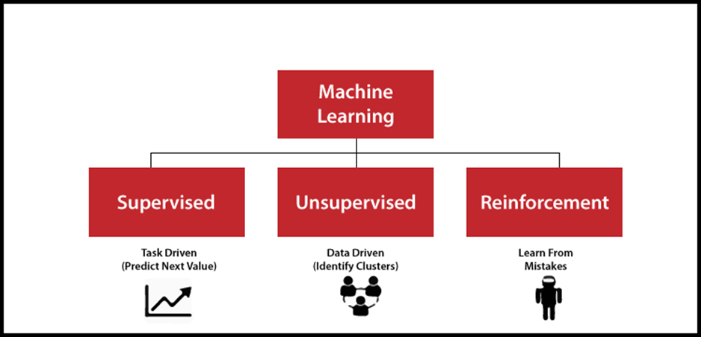
Types of Machine Learning

Slide 10
Supervised Learning
Supervised learning is a type of machine learning method in which we provide sample labelled data to the machine learning system in order to train it, and on that basis, it predicts the output.
The system creates a model using labelled data to understand the datasets and learn about each data, once the training and processing are done then we test the model by providing a sample data to check whether it is predicting the exact output or not.
The goal of supervised learning is to map input data with the output data.

Slide 11
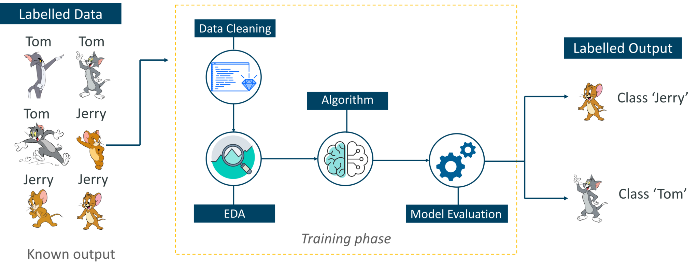
Supervised Learning

Slide 12
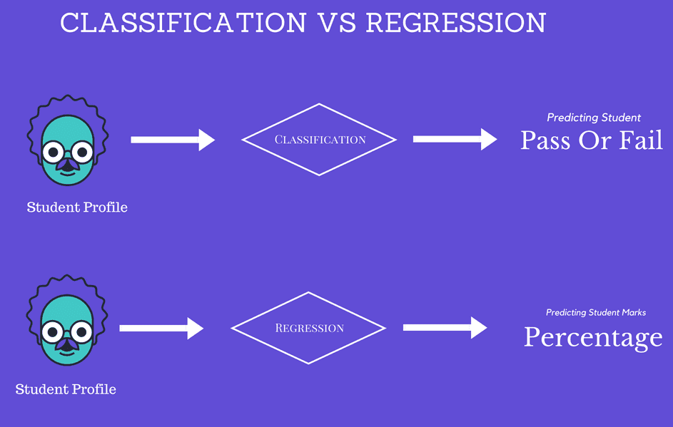
Types of Supervised Learning
Regression: The objective here is to estimate a variable as near to the real output value
Classification: The objective here is to forecast and assess discrete values belonging to a specific class on the grounds of accuracy.

Slide 13
Real – life Applications
Text categorization.
Face Detection.
Signature recognition.
Customer discovery.
Spam detection.
Weather forecasting.
Predicting housing prices based on the prevailing market price.
Stock price predictions, among others.

Slide 14
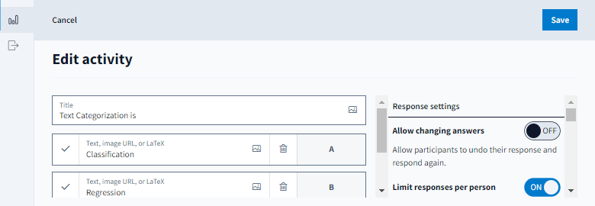

Slide 15
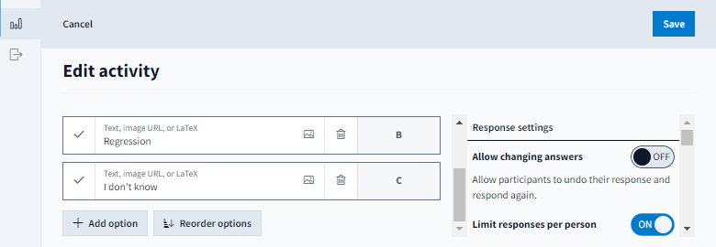

Slide 16
Unsupervised Learning
Unsupervised learning is a learning method in which a machine learns without any supervision.
The training is provided to the machine with the set of data that has not been labeled, classified, or categorized, and the algorithm needs to act on that data without any supervision.
The goal of unsupervised learning is to restructure the input data into new features or a group of objects with similar patterns.

Slide 17
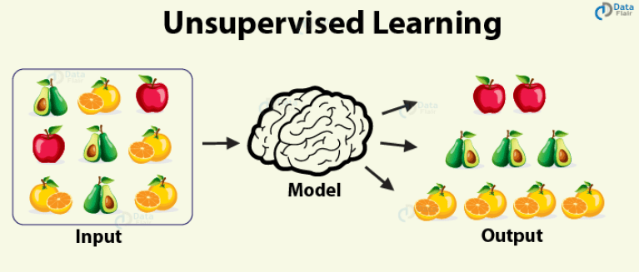
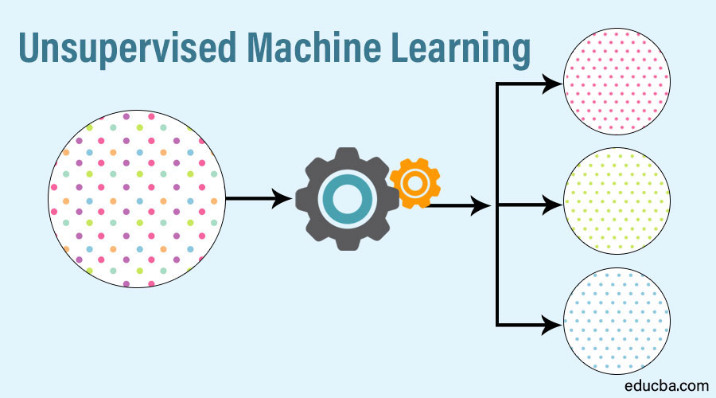

Slide 18
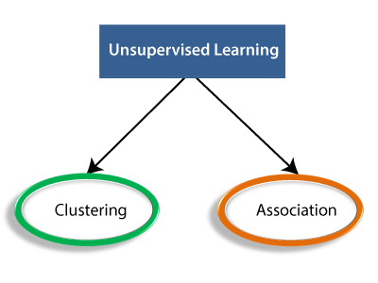
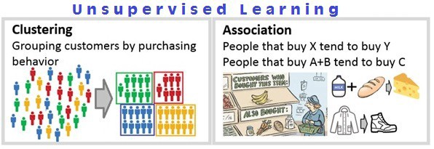

Slide 19
Applications of Unsupervised Learning
Audience segmentation.
Customer persona investigation.
Anomaly detection (for example, to detect bot activity)
Pattern recognition (grouping images, transcribing audio)
Inventory management (by conversion activity or by availability)

Slide 20
Reinforcement Learning
Reinforcement learning is a feedback-based learning method, in which a learning agent gets a reward for each right action and gets a penalty for each wrong action.
The agent learns automatically with these feedbacks and improves its performance. In reinforcement learning, the agent interacts with the environment and explores it.
The goal of an agent is to get the most reward points, and hence, it improves its performance.
The robotic dog, which automatically learns the movement of his arms, is an example of Reinforcement learning.

Slide 21

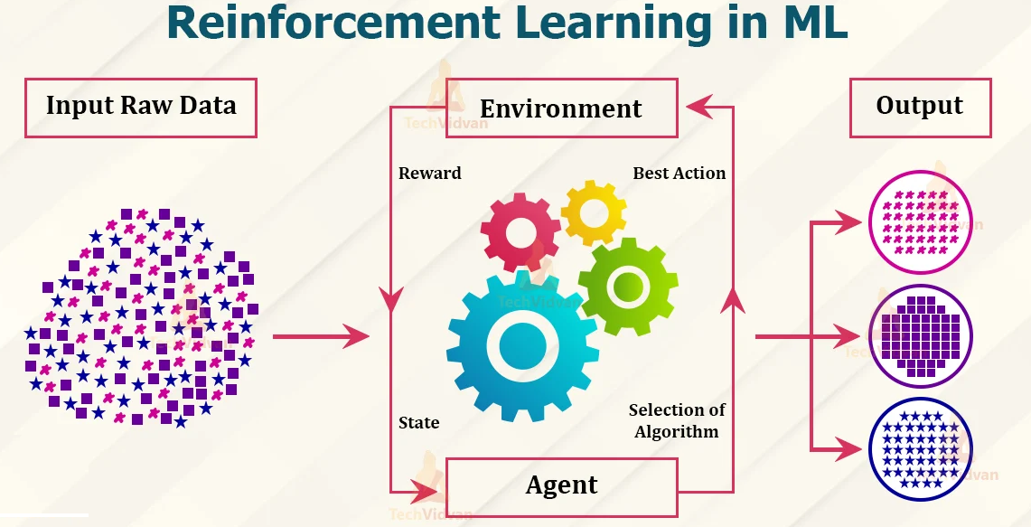

Slide 22
Real Life Applications
Gaming
Robotics
Healthcare : Doctors can discover the treatment type, appropriate doses of drugs, and timings for taking such doses.
Manufacturing
Etc.

Slide 23
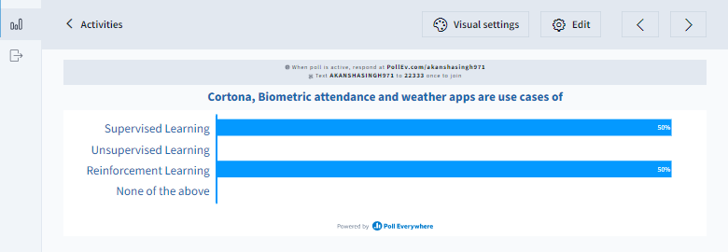

Slide 24


